Slide 1
Clinical Education Research in 2021
Where are we now?
Janice Ellis, Professor of Dental Education, Newcastle University

Slide 2
Incubator Workstreams
Definition/scope & Impact
Branding & engagement
Website, social media strategy, ECR workshop/focus group, launch event
Professional differences
Career opportunities and barriers
Support & development
What needs to happen?

Slide 3
Incubator Workstreams
Definition/scope & Impact
Branding & engagement
Website, social media strategy, ECR workshop/focus group, launch event
Professional differences
Career opportunities and barriers
Support & development
What needs to happen?

Slide 4
Review of NIHR awards from 2005-2020
ClinEd Res projects account for 4.5% of the 1168 funded projects (n=53)
Represent 3.3% (£14.6 million) of a total £445 million awarded over the same period.
An average of £275,084 per award compared to £317,361 (87% of value).

Slide 5
Incubator Workstreams
Definition/scope & Impact
Branding & engagement
Website, social media strategy, ECR workshop/focus group, launch event
Professional differences
Career opportunities and barriers
Support & development
What needs to happen?

Slide 6
Incubator Workstreams
Definition/scope & Impact
Branding & engagement
Website, social media strategy, ECR workshop/focus group, launch event
Professional differences
Career opportunities and barriers
Support & development
What needs to happen?

Slide 7
Professional differences
Screening of NIHR academy membership in order to identify members of the ClinEdRes community (by project or professional background)
Of 3,044 currently active fellows – 21 identified as aligning to ClinEdRes (majority of which were within academy n=19)
Slight male gender balance
19 of the 21 had a medical background
Fellows at predoctoral level are boosted by the specific Academic Clinical Fellowship specialty training posts that are in Medical Education

Slide 8
Where is funding going to?
Region | Institutions | Number of ClinEdR awards
London | Imperial College Healthcare NHS Trust Imperial College of Science, Technology and Medicine King's College London London School of Hygiene and Tropical Medicine Queen Mary University of London Royal National Orthopaedic Hospital NHS Trust University College London | 19
Yorkshire and The Humber | Sheffield Hallam University University of Leeds University of York | 9
North West | University of Manchester University of Lancaster University of Liverpool | 8
South West | University of Bristol University of Plymouth | 5
West Midlands | University of Birmingham University of Keele University of Warwick | 5
North East | Northumbria Healthcare NHS Foundation Trust Newcastle University | 3
East Midlands | University of Nottingham | 2
South Central | University Hospital Southampton NHS Foundation Trust University of Oxford | 2
East of England |  | 0
South East Coast |  | 0
Professional group | Number of ClinEdR awards
Medically Qualified | 23
Not A Registered Health Professional | 15
Nurse | 6
Other Registered Health Professional | 5 (public health, pharmacy and clinical psychology)
Allied Health Professional | 2 (both physiotherapists)
Dentist | 2 (both dental public health)
Midwife
Location of active ClinEdRes fellows similar trends across 10 RDS

Slide 9
What might be barriers?
New discipline
Lack of recognition of ClinEd Research
Models of Education
Lack of Availability of Funding
Cultural
(Real or perceived?)

Slide 10
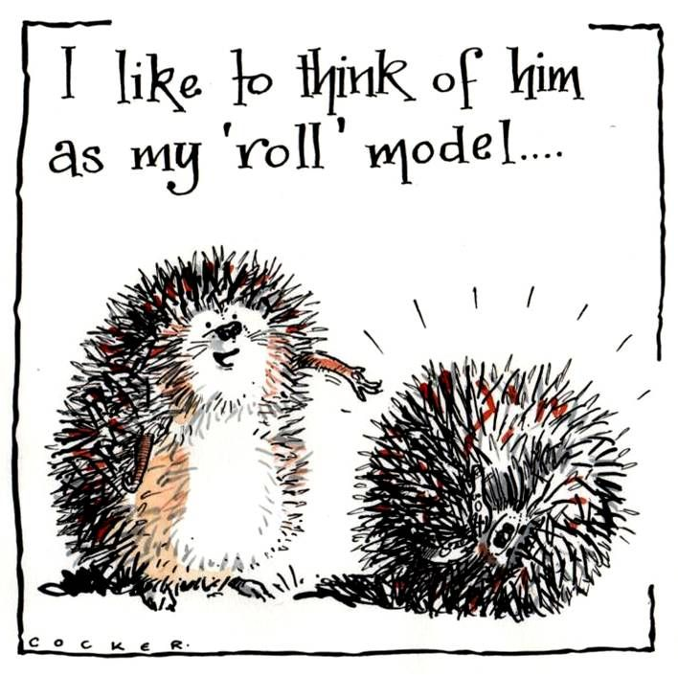
New discipline?
We have been undertaking and publishing in education for a long time
European Journal of Dental Education – volume 1 – 1997
British Journal of Medical Education – volume 1 – 1966
Journal of Nursing Education – volume 1 – 1962

Slide 11
Lack of recognition
UoA 1?
Research Excellence Framework
Promotion opportunities
Academic contracts
“Educational Research is not recognised as a true research theme by the University”.
UoA 3?
UoA 23?

Slide 12
Career Progression

Slide 13
Models of Education
Educators but not researchers
Part time teaching (NHS)
Programme leads/no longer clinical

Slide 14
Funding
I’m not bad……
I’m just misunderstood

Slide 15
Incubator Workstreams
Definition/scope & Impact
Branding & engagement
Website, social media strategy, ECR workshop/focus group, launch event
Professional differences
Career opportunities and barriers
Support & development
What needs to happen?

Slide 16
Breakout
1435-1515
What other barriers/enablers to career development and progression do we need to know about?
What do we need to do to overcome barriers, and which are the priority actions?
Who needs to be involved?
What does ‘ideal’ look like?

